Slide 1
Internet Protocols TCP/IP
Transmission Control
Protocol
Internet Protocol

Slide 2
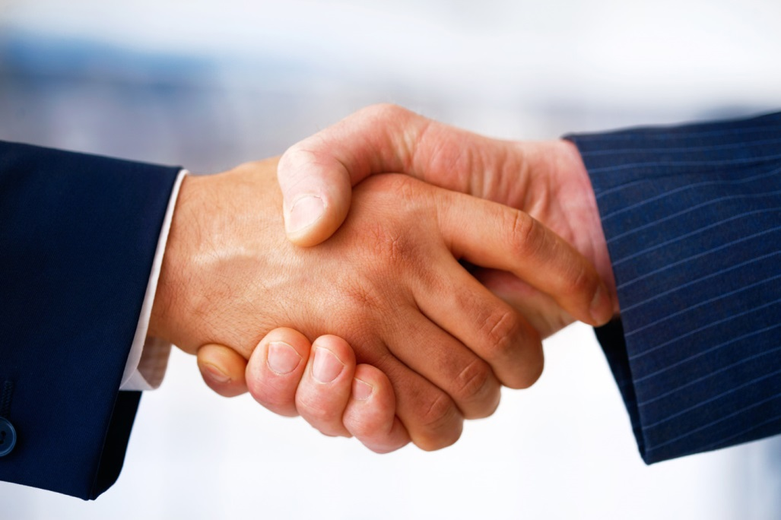
TCP/IP Handshake
Internet exchange begins with TCP handshake
TCP/IP permits connection between any two computers
Notes:
Connections between computers on the Internet are known as “end-to-end.” Two computers establish a connection and then exchange packets. Any computer on the Internet can try to initiate this exchange with any other computer on the Internet.

Slide 3
IP Header Comes First
IP Header
Addressing
Sequencing
TCP Header
Notes:
The first bits communicated in a packet identify the IP addresses of sender and recipient, among other routing information. After the IP header, the TCP header identifies the sequence number of the packet and other error checking information.

Slide 4
Moving from IPv4 to IPv6
IPv4 Addresses ran out
IPv4 address:
74.125.255.0
IPv6 address: FF22:FF22:FF22:FF22:FF22:FF22:FF22:FF22
IPv6 is more secure
Notes:
Most packets carried over the Internet follow version 4 of the Internet Protocol. But IPv4 addresses ran out, forcing the creation of a new protocol, version 6. The new protocol allows the sender to keep more information private.

Slide 5
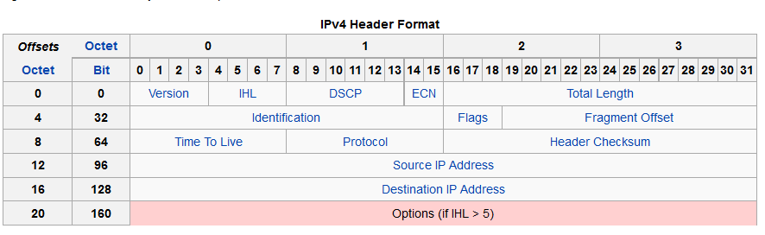
IPv4 Says What to Do, When
Notes:
The IP layer follows this protocol for what the 0s and 1s mean, and in what order. This table shows the full IP header. Each row is 4 bytes long: 32 bits, 32 zeros and ones. The first four bits identify the version number of the IP protocol that is being followed.

Slide 6
IP Packets Contain Data
Protocol:
Say what version of the Internet Protocol
4 in binary = 0 1 0 0
0 1 0 0

Slide 7
IP Packets Specify “to” and “from”
Example: source address 255.1.1.1
You try: destination address 128.1.2.255
0 0 0 0 0 1 1 0
1 1 1 1 1 1 1 1 0 0 0 0 0 0 0 1 0 0 0 0 0 0 0 1 0 0 0 0 0 0 0 1
1 0 0 0 0 0 0 0 0 0 0 0 0 0 0 1 0 0 0 0 0 0 1 0 1 1 1 1 1 1 1 1
Notes:
This packet is from 255.1.1.1 for example. The sender’s address is shown here in bits. 255 has all the bits “on.” The second, third, and fourth bytes of the dotted quad are both 1; only the ones place in each byte is on.

Slide 8
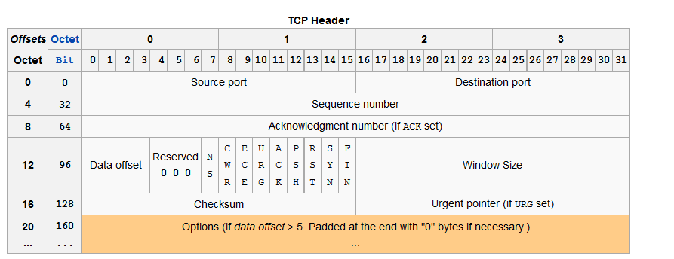
TCP Packet
TCP goes in the body of IP
TCP also has header-body structure
SYN-ACK three way handshake
Notes:
OK, so the IP layer has the addresses. The domain name system gets the packet to the right address.
The central idea here is that protocols allow computers to use 0s and 1s to communicate and to climb the ladder of abstraction by taking care of distinct responsibilities.
The TCP layer doesn’t have to worry about getting to the right computer. It worries about making sure that all the packets arrive and that no mistakes were created switching 1s to 0s. How does that happen?
The TCP handshake uses the SYN/ACK one-bit flags in the TCP header. It also uses the sequence and alignment numbers that are each 32 bits.

Slide 9
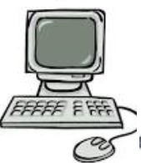
End-to-End Connection Through TCP/IP
Client
Server
Port
80
Port
80
Protocol script:
Host 1: “SYN 67”
Host 2: “ACK 68, SYN 24”
Host 1: “ACK 25”
TCP starts with a three-message handshake.
It lets your partner know you are receiving them.
Notes:
The protocol says who will say what, when. The exchange is between a specific port on each computer. Port 80 , as shown here, is used by webservers and web clients alike to exchange HTTP packets (technically, IP packets containing TCP data containing HTTP data.)
The three-packet TCP handshake is the beginning of any exchange of TCP/IP packets, not just web pages or exchanges between clients and servers – all Internet traffic! Well, most of it… During the TCP handshake, both computers pick a random sequence number and send it with the SYN flag set to 1.
As shown here, the other connection is supposed to respond to a SYN flag with a packet of its own, but with the ACK flag set to 1, and with an acknowledgement number telling what data the acknowledger is ready for. Thus SYN 67 was acknowledged with ACK 68.
In the very same packet as the acknowledgement, the second host has begun its own sequence of transmissions with its random number. Thus SYN 24 gets acknowledged by ACK 25.
This script is intended for humans to practice. Volunteer, one pair at a time, to make the TCP handshake aloud for the class. Another example script:
Initiator: “SYN 6”
Responder: “ACK 7, SYN 58”
Initiator: “ACK 59”
Note: This script shows the acknowledger only going up by 1. This is technically incorrect for two reasons:
The IP packets also say how long they are, and the SYN is incremented by the number of bytes.
The ACK number might jump several packets if packets 22, 23, and 24 arrive while the recipient is still waiting for packet 21. When packet 21 finally comes along, the recipient will send ACK 25, except with the “25” indicating the starting byte number at which packet 25 will continue the transmission.

Slide 10
TCP Packet
Also has header-body structure
SYN-ACK three way handshake
0 0 0 0 0 0 0 0 0 0 0 0 0 0 0 0 0 0 0 0 0 0 0 0 0 0 0 0 0 1 1 0
0
1
Notes:
Here, for example, is the TCP header for a SYN 6 packet.
That was the first in the following handshake.
Initiator: SYN 6
Responder: ACK 7, SYN 58
Initiator: ACK 59
What does the next header look like?

Slide 11
HTTP Header
In the body of a TCP packet
HTTP/1.1 200 OK
Wed, 13 Nov 2013 00:43:02 GMT\r\n
Expires: -1\r\n
Cache-Control: private, max-age=0\r\n
Content-Type: text/html; charset=ISO-8859-1\r\n
Set-Cookie: PREF=ID=fea989171d7:FF=0:TM=13843382:LM=13843082:S=D5L2sfD; expires=Fri, 13-Nov-2015 00:43:02 GMT; path=/; domain=.google.com\r\n',
Set-Cookie: NID=67=lwxmW; expires=Thu, 15-cMay-2014 00:43:02 GMT; path=/; domain=.google.com; HttpOnly\r\n',
P3P: CP="This is not a P3P policy! See http://www.google.com/support/accounts/bin/answer.py?hl=en&answer=151657 for more info."\r\n',
Server: gws\r\n
X-XSS-Protection: 1; mode=block\r\n
X-Frame-Options: SAMEORIGIN\r\n
Alternate-Protocol: 80:quic\r\n
Connection: close\r\n
Request Line or Status Line
The rest of HTTP header
Notes:
Climbing the ladder of abstraction, we now work with HTTP. We no longer have to worry about how the packets got here, or how we made sure we had them all. We can start talking about the higher level content that was transmitted. HTTP has a header and a payload. An HTTP header’s first line sums it up: “200 OK”. In the protocol that’s the agreed upon code for “I’ve got that web page. Here it comes…”

Slide 12
HTTP Body
HTML
<HTML>
<HEAD>
<TITLE>Great web page</TITLE>
</HEAD>
<BODY>
Some great content
</BODY>
</HTML>
Notes:
Finally, inside the body of the HTTP packet is HTML content. Note that the content might be split among many TCP/IP packets. They are reassembled by the client host, using the sequence numbers in the TCP header before the client’s computer delivers the web page to the client’s web browser. So now we’re finally high up in the layers of abstraction, where you can write code in HTML to communicate your content and add CSS to communicate how you want that content rendered.

